Slide 1
Presentation Title
By Author
Date

Slide 2
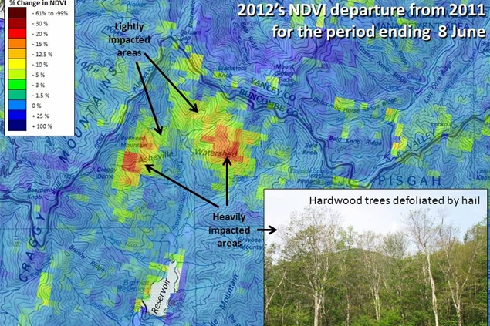
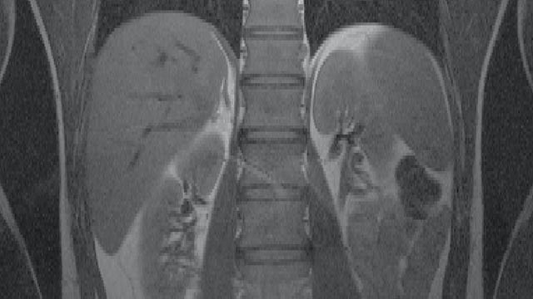
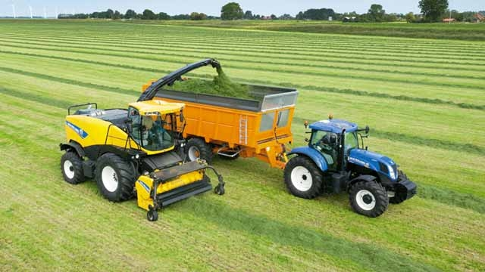
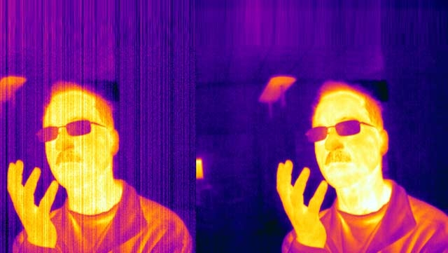
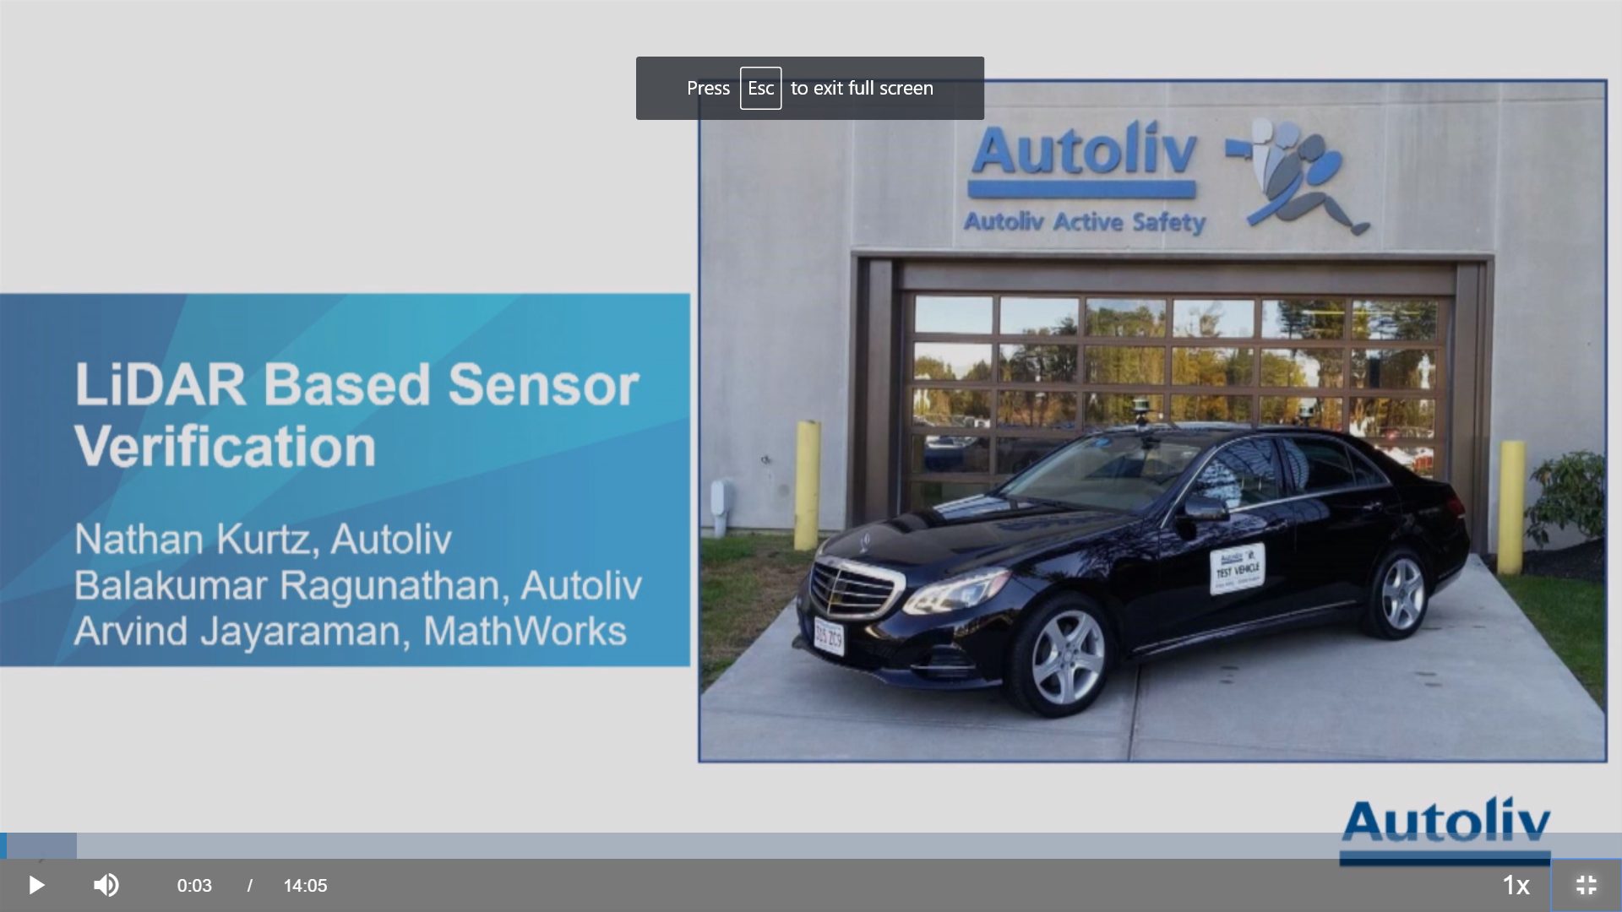
Image Processing and Computer Vision Applications
NASA Develops Warning System for Detecting Forest Disturbances
Beth Israel Medical Center Improves MRI Accuracy
CNH Develops Intelligent Filling System for Forage Harvesters
FLIR Accelerates Development of Thermal Imaging FPGA
Veoneer (Autoliv) Builds Radar Sensor using LiDAR-Based Verification
Notes:
Mention that these are all user stories and that people can look on the website if they’re interested in learning how to accomplish these workflows.
NASA: https://www.mathworks.com/company/user_stories/nasa-develops-early-warning-system-for-detecting-forest-disturbances.html
FLIR: https://www.mathworks.com/company/user_stories/flir-accelerates-development-of-thermal-imaging-fpga.html
Beth Israel: https://www.mathworks.com/company/user_stories/beth-israel-deaconess-medical-center-improves-mri-accuracy.html
CNH: https://www.mathworks.com/company/user_stories/cnh-develops-intelligent-filling-system-for-forage-harvesters.html
Veoneer: https://www.mathworks.com/videos/automated-lidar-point-cloud-annotation-for-sensor-verification-1527491006097.html

Slide 3

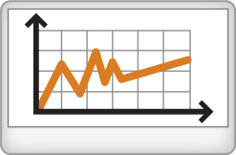
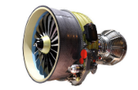

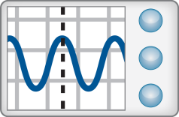
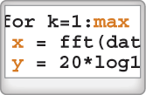
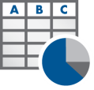
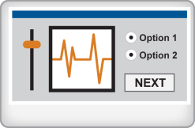



Image Processing Workflow
Access Data
Explore and Discover
Share Results
Files
Data Analysis and Modeling
Embedded Code
Algorithm Development
Enterprise Application
Hardware
Application
Creation
Software
Reports
Iterate and Automate
Notes:
Access and Explore data – files, hardware, software
Explore and Discover – this is the part we will focus on today. We iterate on these steps to get the results we want, then look to scale and automate our analysis.
After building applications and algorithms, you can deploy them to embedded devices, scale them up to the cloud or generate documents and reports.

Slide 4
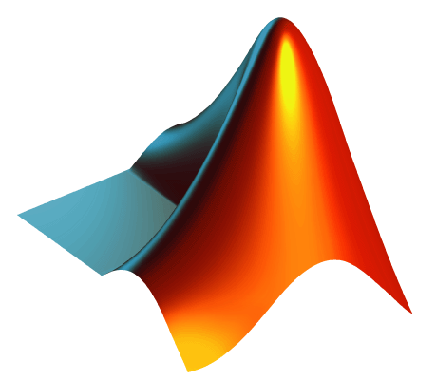
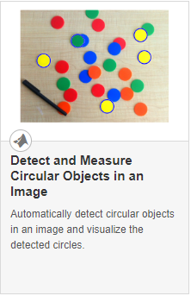
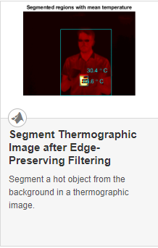
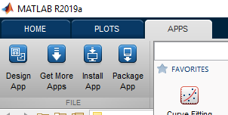
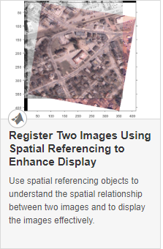
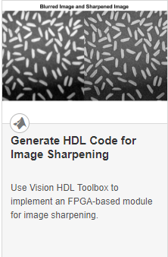
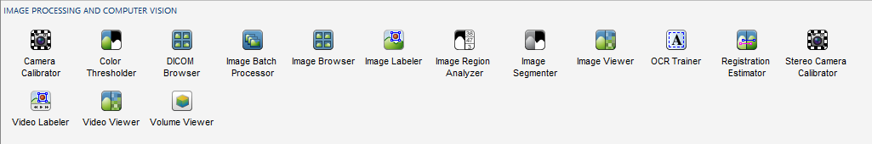

Why Use MATLAB?
Ease of Use and Thorough Documentation
Rapid Prototyping and Algorithm Development
Code Generation for Embedded Deployment
MATLAB Code
(…)
Embedded Hardware
C, C++
HDL
GPU
Need Technical Help?
Technical Support
Application Engineers
Notes:
Talk about general ease of use of MATLAB (easy syntax, great documentation examples apps to accelerate the process, access to technical support).
Apps – visual and interactive algorithm development + function generation = ability to rapidly prototype. Productivity boost!
Code generation – save time by generating embedded code from MATLAB code (standard coder product messaging)

Slide 5
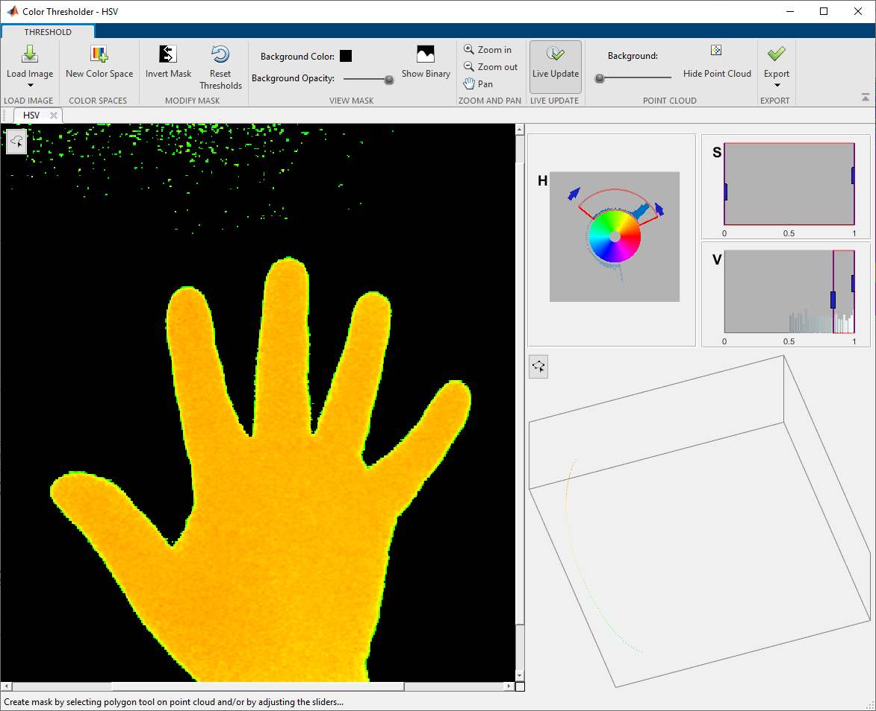
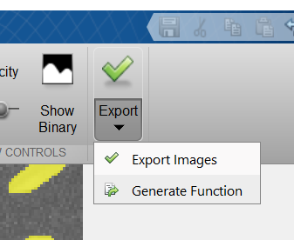
Apps Accelerate Workflows
Color Thresholder App
Notes:
IPCV ships with many apps that accelerate workflow. They provide interactive tools for tweaking parameters and visualizing results. When you are finished developing an algorithm, you can export your results or generate a function to scale your algorithm to a larger dataset

Slide 6
Image Processing Toolbox & Computer Vision Toolbox
Import, Display, and Exploration
Camera Calibration and 3D-Vision
Geometric Transform and Image Registration
Tracking and Motion Estimation
Image Filtering and Enhancement
Feature Detection and Extraction
Image Segmentation and Analysis
LiDAR and Point Cloud Processing
3D Volumetric Processing
Deep Learning
Notes:
People often ask what is the difference between IP and CV toolbox. This will clarify the functionality contained within the toolboxes.

Slide 7
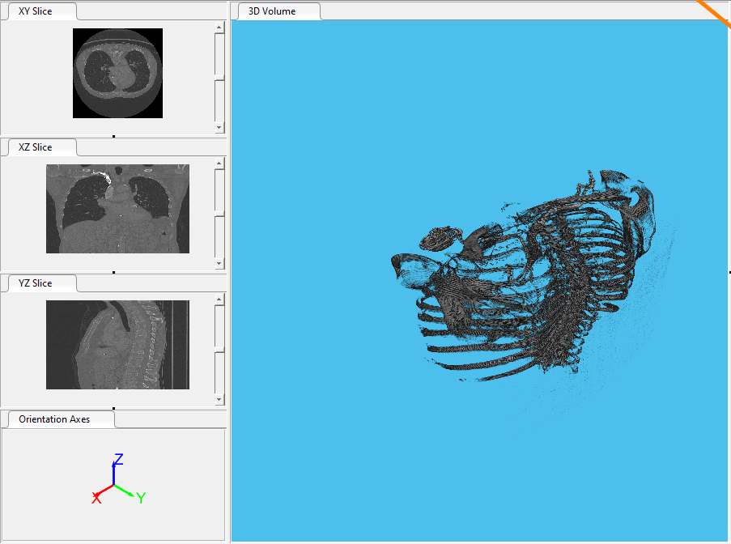
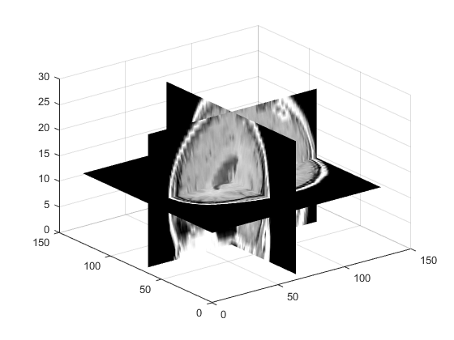
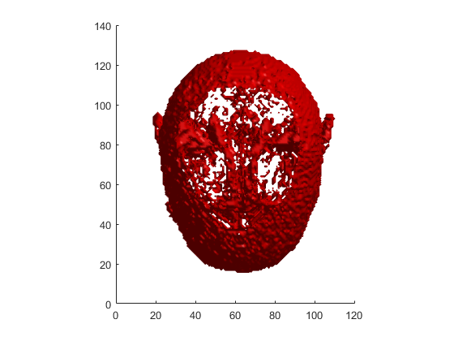
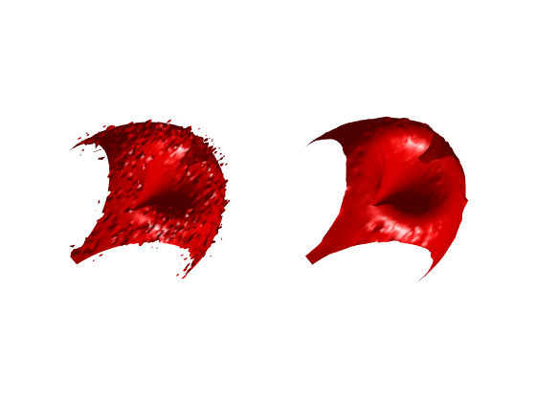
3-D Image Processing Functions and Apps
Over 65 functions supported for 3-D volumetric data
imresize3, imrotate3
activecontour
Volume Viewer App
Example: Segment Lungs from 3-D Chest Scan
medfilt3
Notes:
Image processing toolbox has support for over 65 functions that perform pixel operations, local filtering, morphology, and other image processing to work with 3-D data sets.
Volume viewer app enables interactively visualizing volumetric and labeled volumetric data

Slide 8
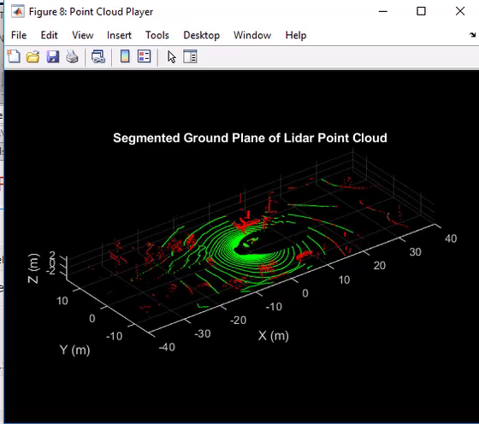
Lidar and Point Cloud Processing
Example: Track Vehicles Using Lidar: From Point Cloud to Track List
Notes:
Point clouds are typically used to measure physical world surfaces. They have applications in robot navigation and perception, depth estimation, stereo vision, visual registration, and in advanced driver assistance systems (ADAS).
Computer Vision Toolbox™ algorithms provide point cloud processing functionality for downsampling, denoising, and transforming point clouds.
The toolbox also provides point cloud registration, geometrical shape fitting to 3-D point clouds, and the ability to read, write, store, display, and compare point clouds. You can also combine multiple point clouds to reconstruct a 3-D scene

Slide 9
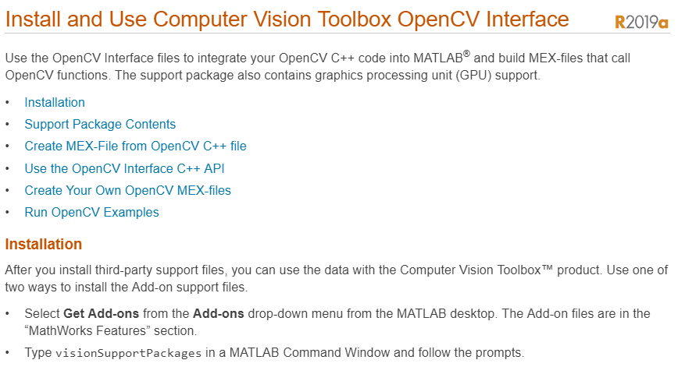
OpenCV Interface
Bring OpenCV C/C++ code into MATLAB using MEX
Ships with OpenCV-binaries (v3.4.0 as of 2018b)
Large library of data type conversions
Several examples to help get started
Notes:
Use the OpenCV Interface files to integrate your OpenCV C++ code into MATLAB and build MEX-files that call OpenCV functions.

Slide 10
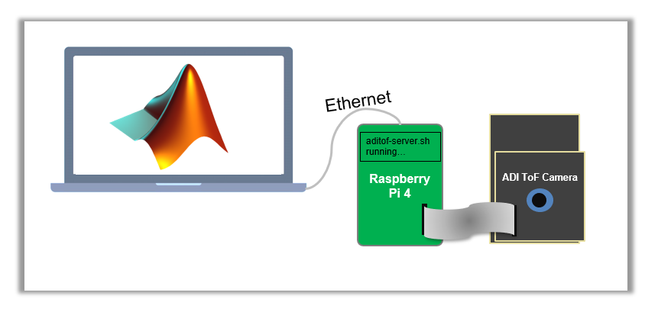
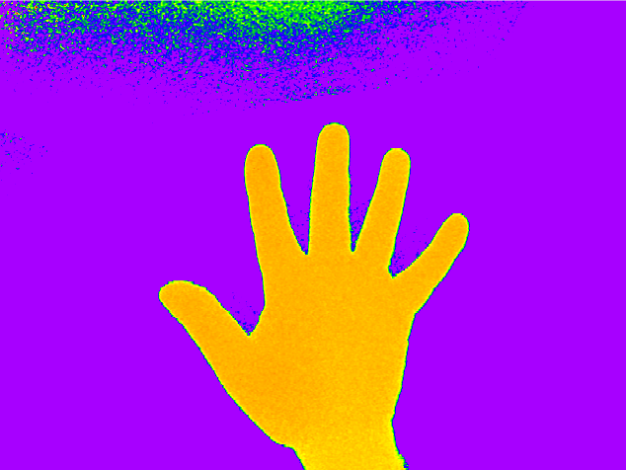

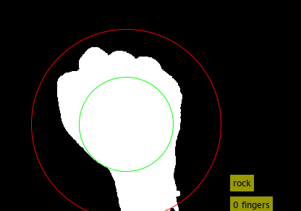
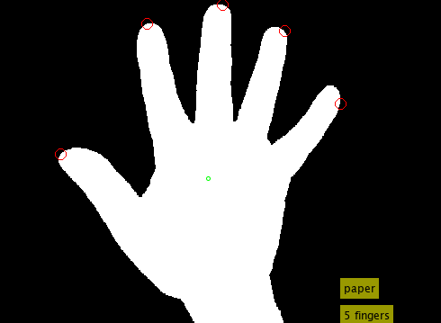
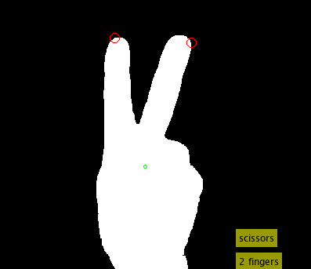
MATLAB with ADI ToF Camera
ToF Camera makes it easy to find the hand
MATLAB is used to figure out hand signal
Demo: Rock, Paper, Scissors
NOTE: Additional toolboxes required are Image Processing, Computer Vision, and Image Acquisition

Slide 11

Step 1 – Detect the hand
Grab image from camera
depthMap = getsnapshot(depthVid);
Convert to HSV color space, threshold, and clean up edges
hsv = rgb2hsv(depthMap);
BW = hsv(:,:,1) <= 0.25;
BW = imopen(BW,strel('disk',3));
BW = imfill(BW,'holes');

Slide 12
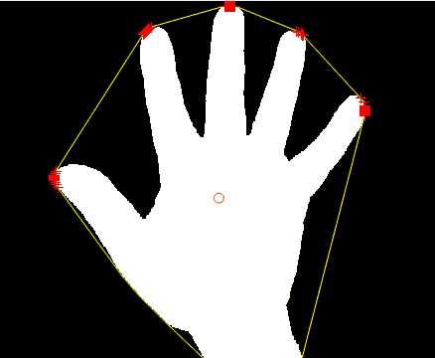
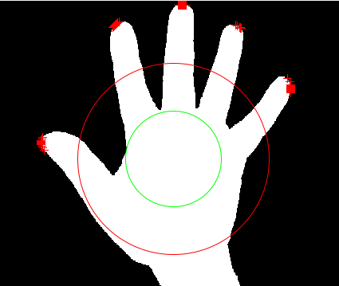
Step 2 – Measure hand, determine if fingers are extended
Determine hand area, centroid, and convex hull
Convex hull allows us to find the fingers
blobs = regionprops(BW,'Area','Centroid','ConvexHull’);
Determine if fingers are extended
Distance transform helps us estimate radius (green line)
bwd = bwdist(~BW);
radius = bwd(round(c(2)), round(c(1)));
Sub-select for the points outside 2*radius estimate (red line)
d = sqrt((x-c(1)).^2+(y-c(2)).^2);
x((d - 2*radius)<0) = 0;
y((d - 2*radius)<0) = 0;

Slide 13
Step 3 – Count the number of fingers
Eliminate points within 10 pixels of each other
If no fingers, then it’s “rock”
If 1 finger, then it’s “unclassified”
If 2 fingers, then it’s “scissors”
If 3-5 fingers, then it’s “paper”

Slide 14
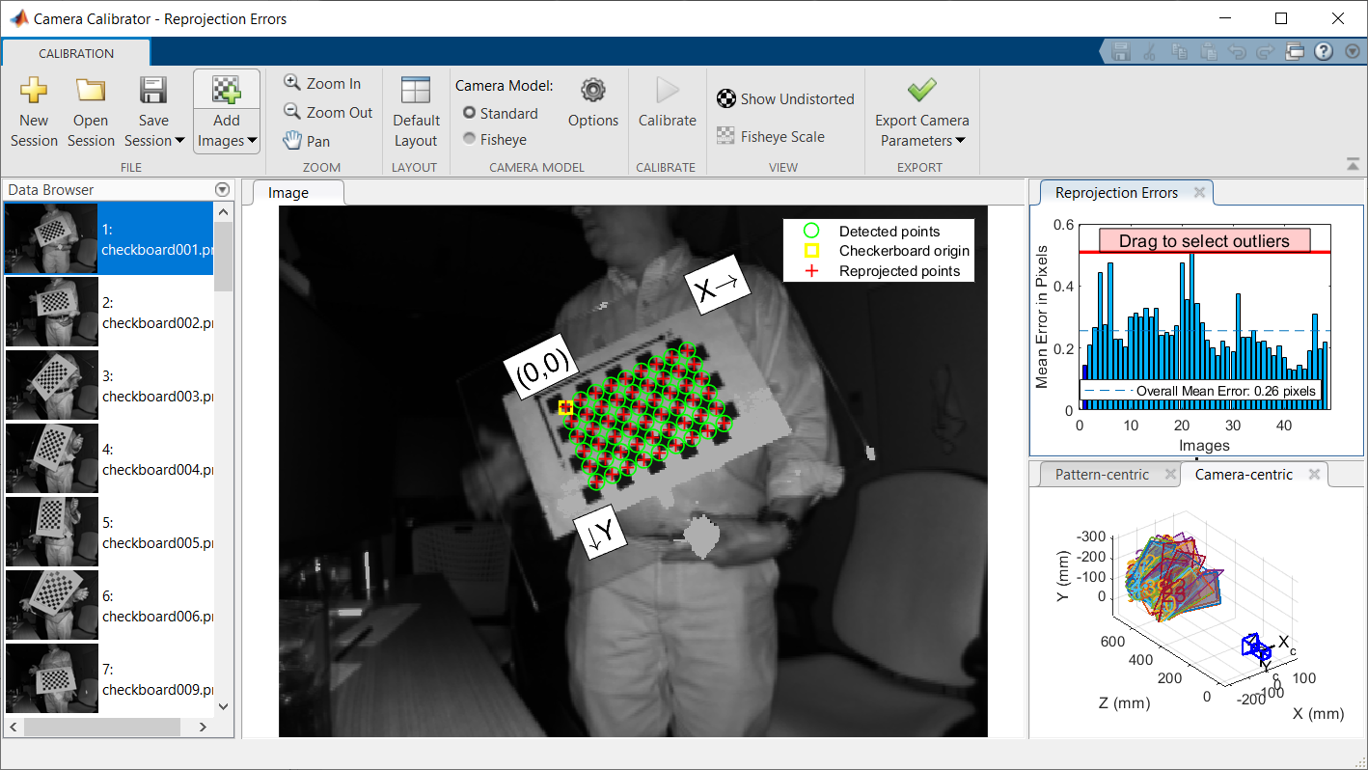
Accelerate Calibration Workflow with cameraCalibrator
Steps
Use checkboard printout with squares of a known size (29mm in this case)
Load into Camera Calibrator app
Press the calibration button
Inspect results

Slide 15
Next Steps
Use executable provided to try it yourself
Download the code
Evaluate MATLAB, Image Processing Toolbox, Computer Vision Toolbox, and Image Acquisition Toolbox

